Slide 1

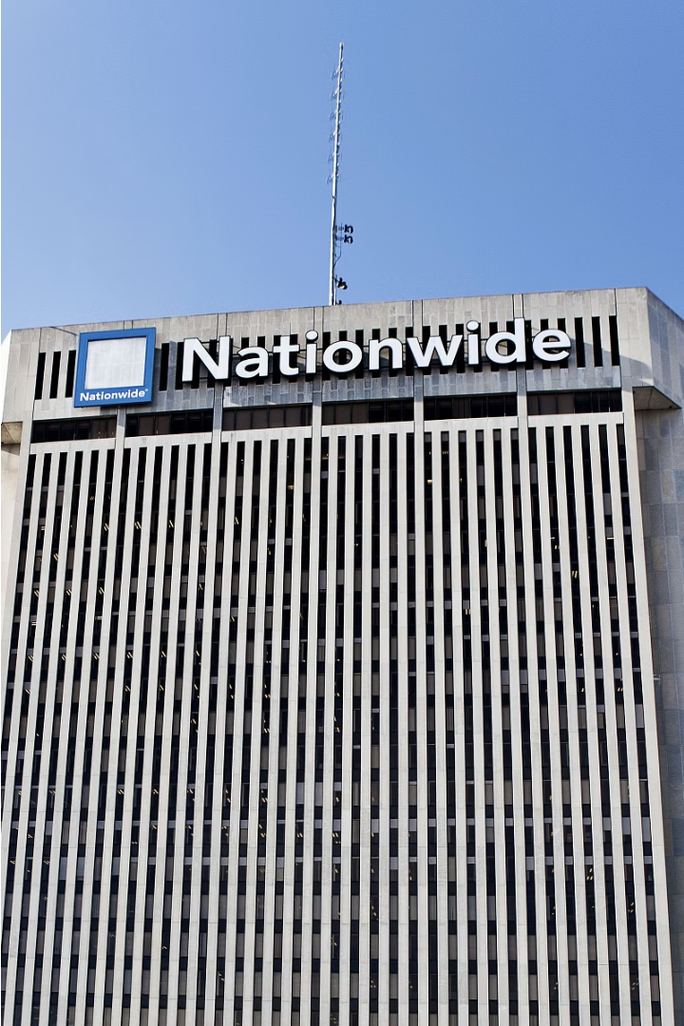
Insurance Price Prediction
This presentation explores the exciting intersection of Artificial Intelligence, Machine Learning, and the crucial field of insurance price prediction. Together, we'll dive into innovative techniques that can revolutionize the insurance industry.
Submitted By-
Rajkirat Singh 2210990709
Rajveer Singh 2210990711
Ranveer Singh 2210990718
Rohit Chauhan 2210990742

Slide 2
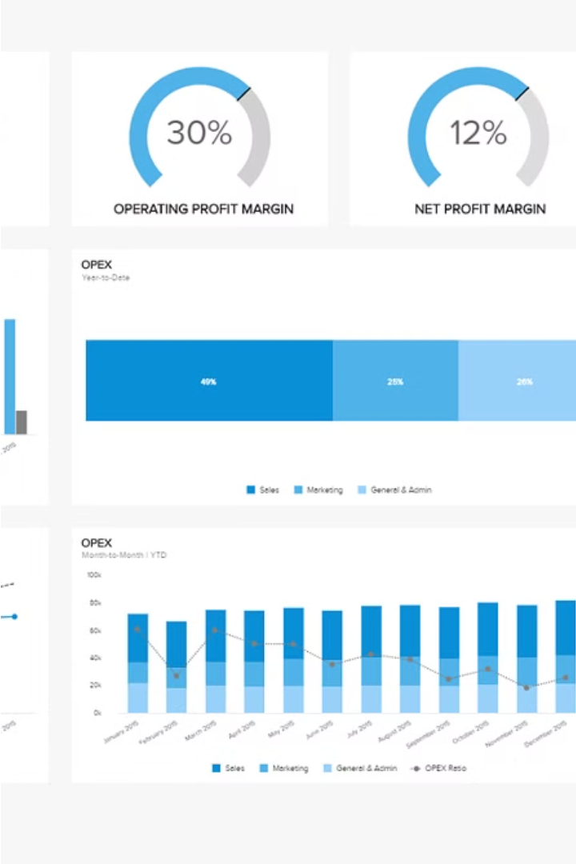
Introduction
This project aims to harness the power of Artificial Intelligence and Machine Learning to revolutionize the field of insurance price prediction. By leveraging advanced algorithms and data analytics, we can develop a comprehensive solution that helps insurance providers offer accurate, personalized pricing to their customers.

Slide 3

Brief Overview of the Project
Leveraging advanced AI and ML algorithms to develop a comprehensive insurance price prediction solution
Aim to provide accurate and personalized pricing to insurance customers by analyzing extensive data
Utilize cutting-edge data analytics techniques to uncover insights and patterns in insurance data

Slide 4
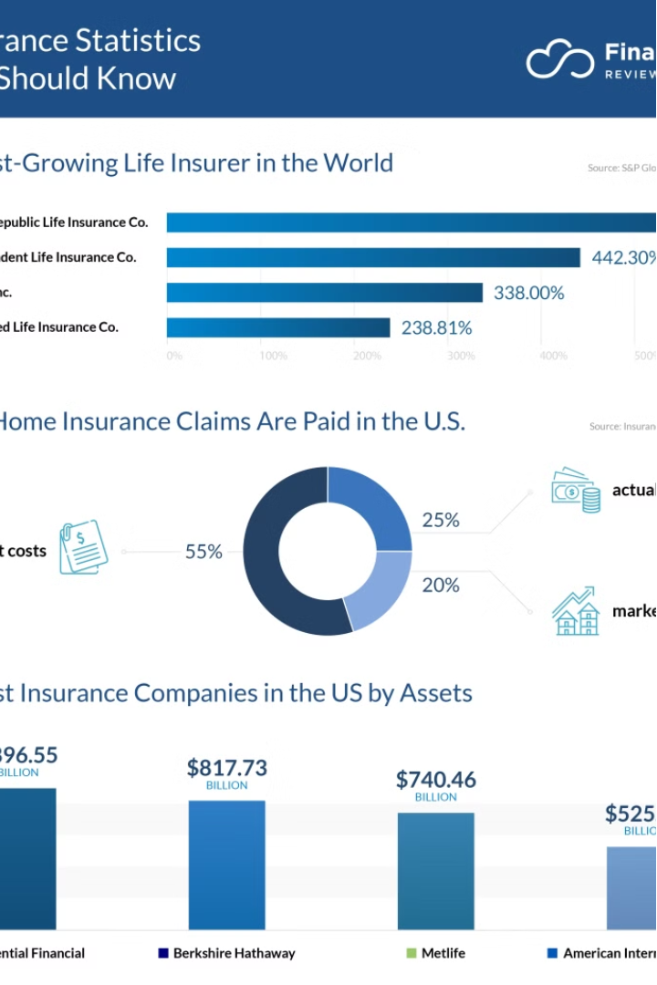
Importance of Insurance Price Prediction
Accurate insurance price prediction is crucial for the industry. It enables providers to offer competitive and personalized rates, improving customer satisfaction and retention. Precise pricing also helps insurers manage risk effectively, optimizing their financial performance and sustainability.

Slide 5

Objective of the Project
The primary objective of this project is to leverage advanced AI and machine learning algorithms to develop a comprehensive insurance price prediction solution. By harnessing the power of data analytics, we aim to provide accurate and personalized pricing to insurance customers, improving customer satisfaction and retention. Ultimately, this project seeks to revolutionize the insurance industry through innovative technology and data-driven insights.

Slide 6

Problem Statement
Accurately predicting insurance prices is a complex challenge that requires analyzing vast amounts of data, from customer demographics to historical claims. The goal is to develop a robust AIML-based solution that can provide personalized, competitive pricing to insurance customers.

Slide 7
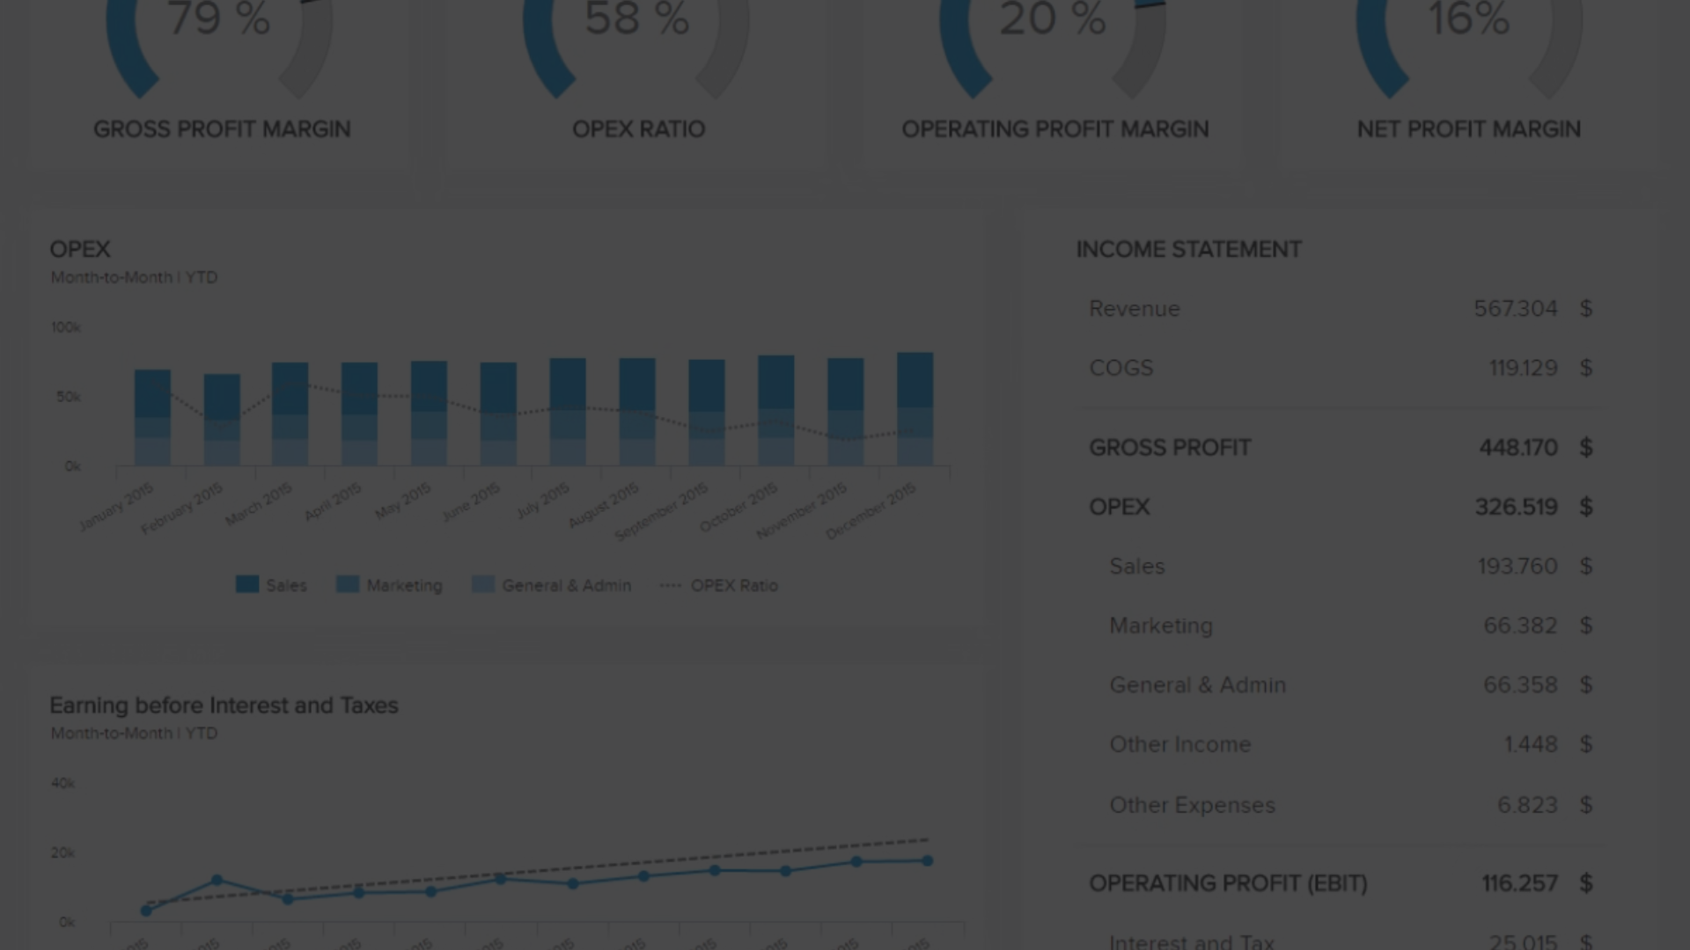
Problem Statement
Accurately predicting insurance prices is a complex challenge that requires analyzing vast amounts of customer data, including demographics, insurance history, and risk factors. The goal is to develop a robust AIML-based solution that can provide personalized, competitive pricing to insurance customers, improving customer satisfaction and retention.

Slide 8
Challenges in Insurance Price Prediction
Vast and complex customer data to analyze, including demographics, claims history, and risk factors
Capturing the dynamic nature of insurance markets and customer behavior over time
Accounting for regional and regulatory variations that impact insurance pricing across different locations

Slide 9

Data Collection and Preprocessing
Gathering comprehensive insurance data from diverse sources is crucial for accurate price prediction. We will leverage advanced data engineering techniques to clean, transform, and integrate this complex information into a cohesive data platform.

Slide 10

Data Collection and Preprocessing
Leverage extensive insurance industry databases to gather comprehensive data on customer demographics, policy details, and historical claims
Integrate publicly available data sources such as government statistics, economic indicators, and weather patterns to enrich the dataset
Utilize cutting-edge data engineering tools and techniques to clean, standardize, and transform the complex, multi-source data into a cohesive, analytics-ready platform

Slide 11
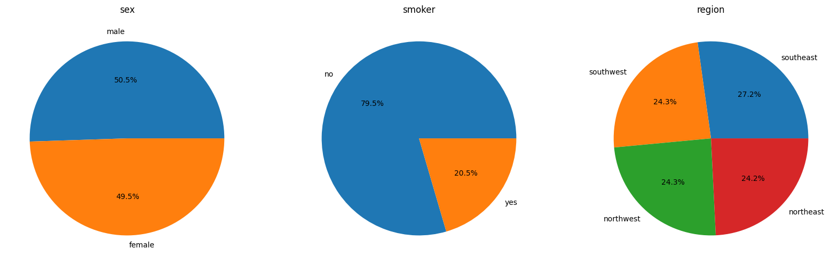

Fv
Sex: This pie chart shows the distribution of males and females. Males make up 50.5% and females make up 49.5% of the population.
Smoker Status: This pie chart represents smokers and non-smokers. Non-smokers make up the majority at 79.5%, while smokers constitute 20.5%.
Region: This pie chart is divided into four regions: southwest, southeast, northwest, and northeast. Each region occupies approximately a quarter of the chart with slight variations in percentages: southwest (24.3%), southeast (27.2%), northwest (24.3%), and northeast (24.2%).

Slide 12
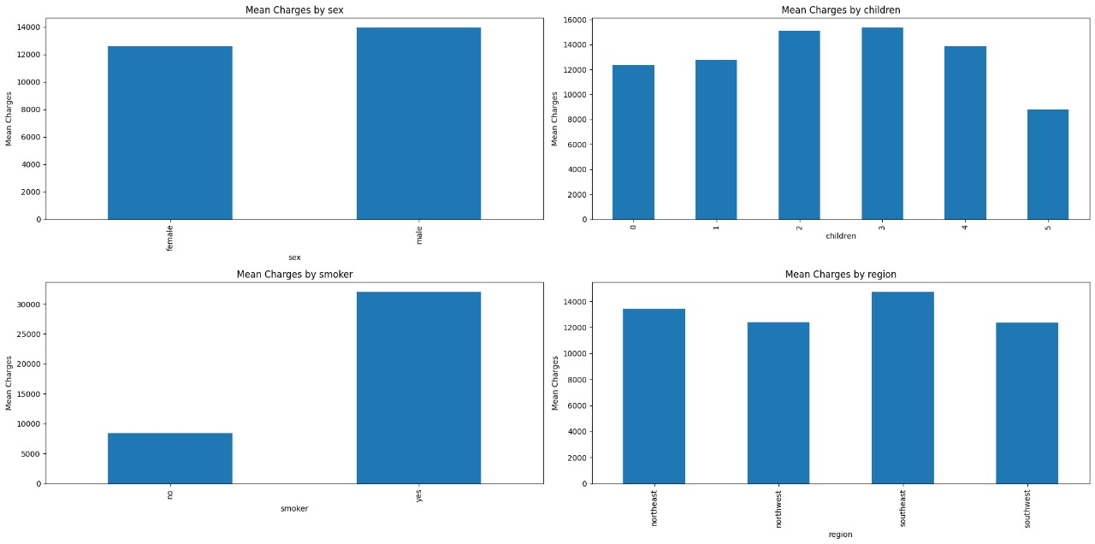
Mean Charges by Sex: This graph compares the mean charges for females and males. The bars are almost equal in height, indicating that the mean charges are similar for both genders.
Mean Charges by Children: This graph shows the mean charges for individuals with 0 to 5 children. The mean charges appear to increase with the number of children until it reaches four, after which it decreases for individuals with five children.
Mean Charges by Smoker: This graph compares the mean charges for smokers and non-smokers. The bar for smokers is significantly higher than for non-smokers, indicating that smokers have higher mean charges.
Mean Charges by Region: This graph shows the mean charges for four different regions: southwest, southeast, northwest, and northeast. The heights of the bars are relatively similar, indicating that the mean charges are comparable across all regions.

Slide 13
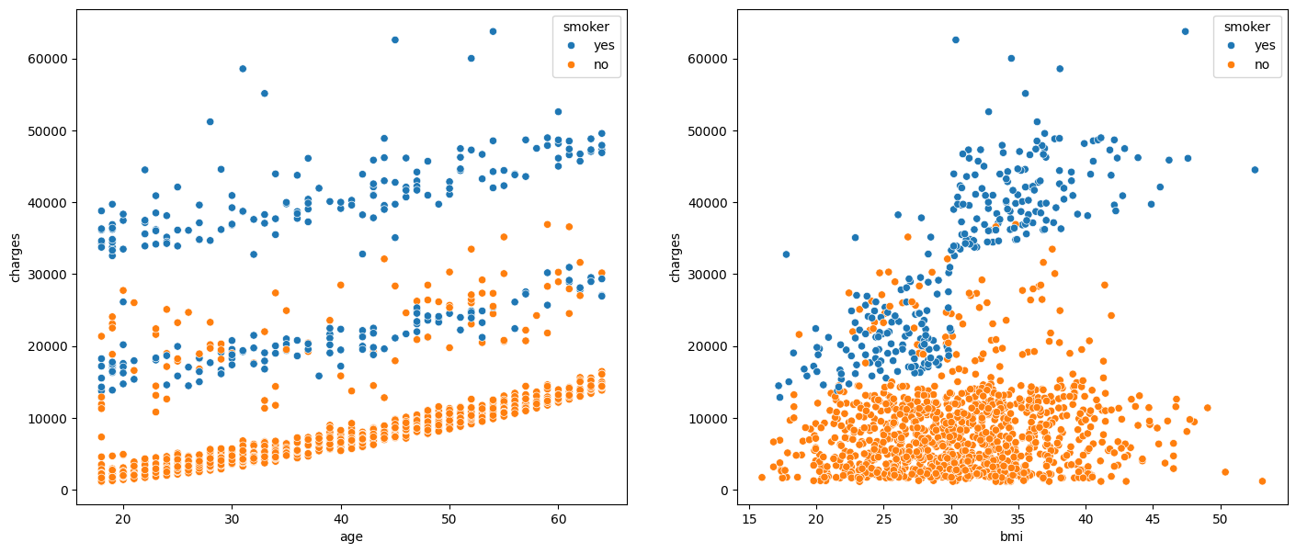
U
Charges vs Age: This plot, on the left, shows the correlation between charges and age. As age increases, the charges for both smokers and non-smokers tend to increase. However, smokers generally have higher charges than non-smokers of the same age.
Charges vs BMI: This plot, on the right, shows the correlation between charges and BMI. As BMI increases, so do the charges. Smokers with higher BMIs incur significantly higher charges than non-smokers with the same BMIs.

Slide 14
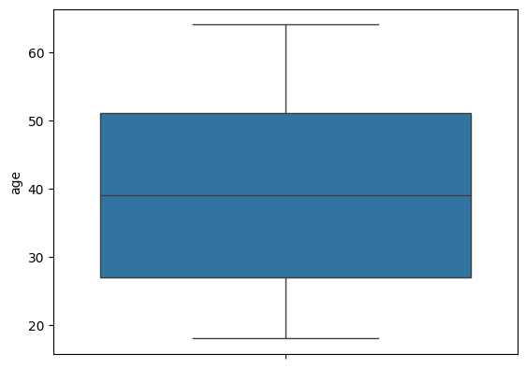
Minimum: The bottom whisker of the box plot represents the minimum value in the dataset, which appears to be around 35.
First Quartile (Q1): The bottom of the box represents the first quartile, which is the 25th percentile of the dataset. This value appears to be slightly above 40.
Median: The line inside the box represents the median (or second quartile), which is the 50th percentile of the dataset. This value appears to be around 45.
Third Quartile (Q3): The top of the box represents the third quartile, which is the 75th percentile of the dataset. This value appears to be just below 50.
Maximum: The top whisker of the box plot represents the maximum value in the dataset, which appears to be around 55.

Slide 15
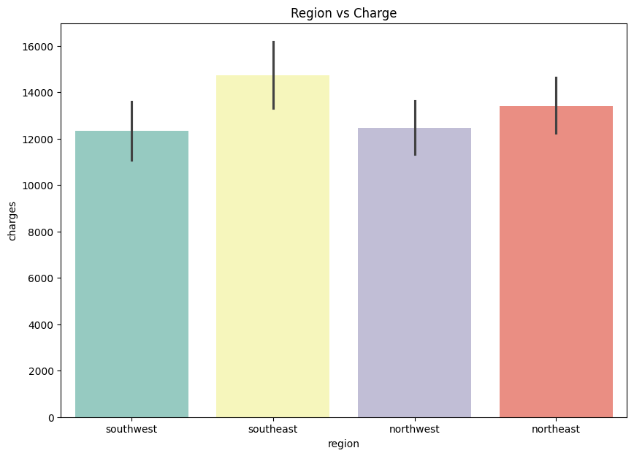
Southwest (Green Bar): The green bar represents the average charge in the southwest region.
Southeast (Yellow Bar): The yellow bar represents the average charge in the southeast region, which appears to be the highest among the four regions.
Northwest (Purple Bar): The purple bar represents the average charge in the northwest region.
Northeast (Red Bar): The red bar represents the average charge in the northeast region.
The error bars on each bar represent the variability or uncertainty in the data, showing the range within which most charges fall in each region.

Slide 16
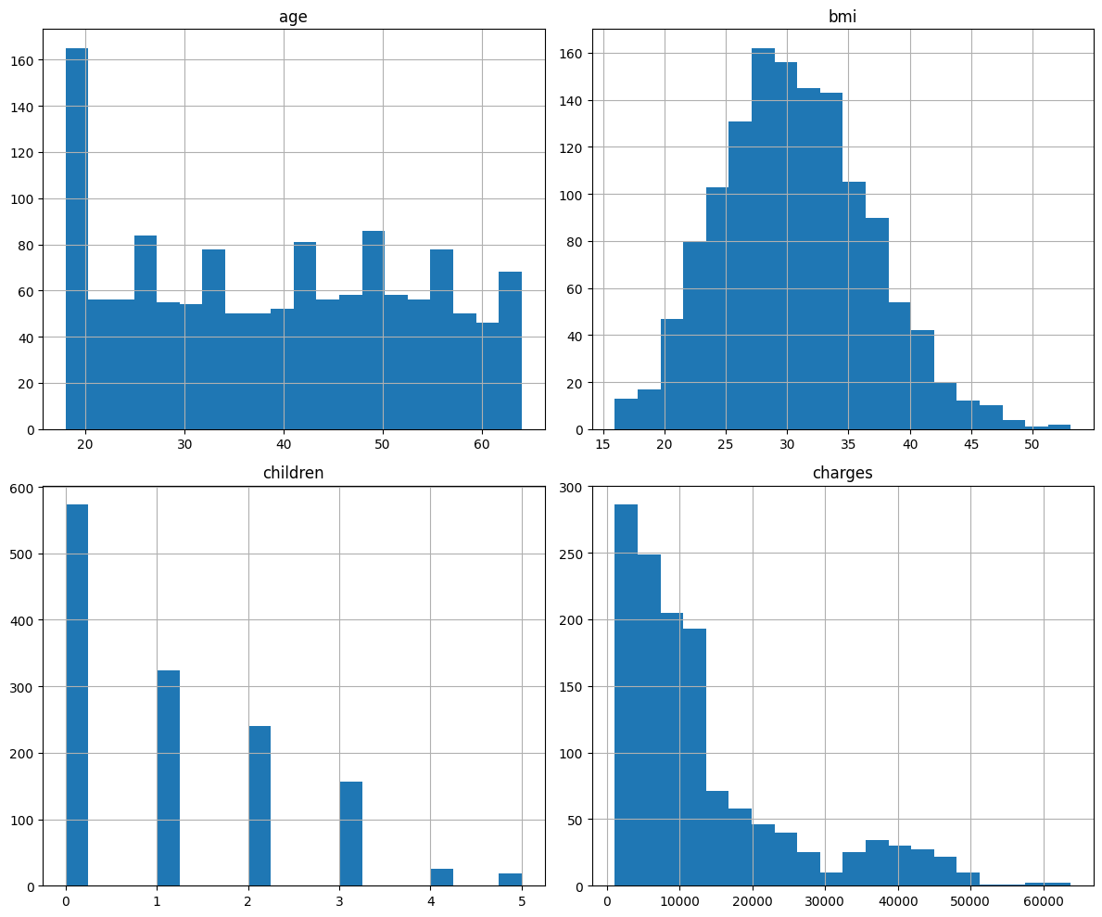
Age Histogram (Top Left): This histogram represents the distribution of ages. There is a significant number of individuals in their early twenties, with the frequency decreasing as age increases.
BMI Histogram (Top Right): This histogram displays the distribution of BMI values. Most individuals have a BMI between approximately 25 and 35.
Children Histogram (Bottom Left): This histogram indicates the number of children people have. A high number of people have no children, and the frequency decreases as the number of children increases.
Charges Histogram (Bottom Right): This histogram represents some type of charges or costs associated with individuals. Most people incur lower charges, with fewer people incurring higher charges.

Slide 17
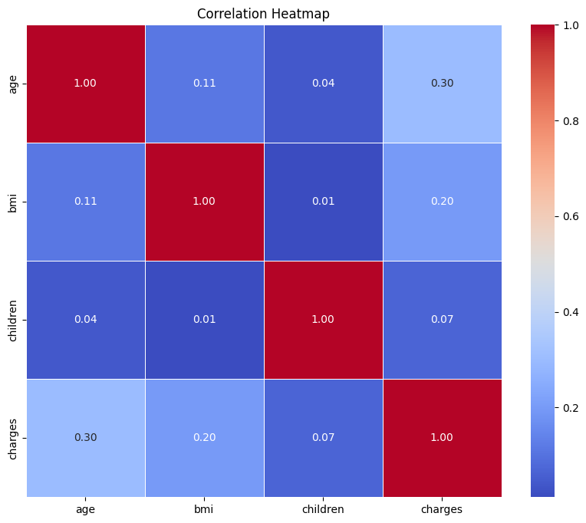
Age: The correlation of age with itself is 1 (a perfect positive correlation), as expected. Age has a moderate positive correlation of 0.30 with charges, indicating that charges tend to increase as age increases. Age has a very weak positive correlation with BMI (0.11) and an extremely weak positive correlation with the number of children (0.04).
BMI: BMI has a weak positive correlation with charges (0.20), indicating that charges tend to slightly increase as BMI increases. BMI has an extremely weak positive correlation with the number of children (0.07).
Children: The number of children has a very weak correlation with charges (0.01), indicating that the number of children has almost no effect on the charges.
Charges: The correlation of charges with itself is 1, as expected.

Slide 18
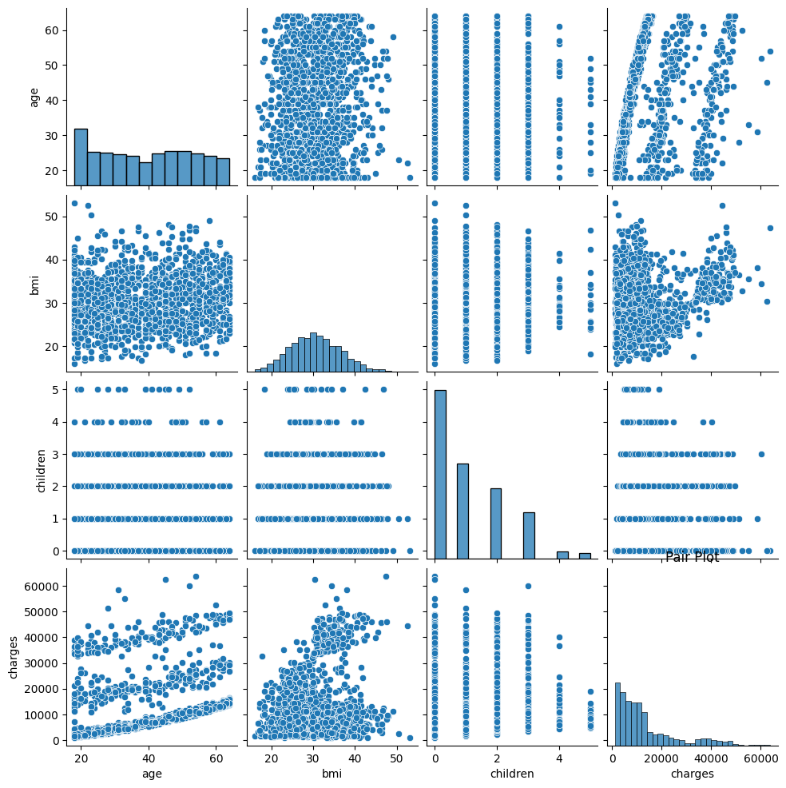
Histograms: The diagonal from top left to bottom right contains histograms for each variable respectively:
Age Histogram: Shows distribution from around 20 to over 60 years old.
BMI Histogram: Peaks around 30.
Children Histogram: Shows most people have less than 3 children.
Charges Histogram: Indicates most charges are below $20,000 but extends up to $60,000.
Scatter Plots: Scatter plots fill the other cells showing correlations or lack thereof between pairs of variables:
Age vs Charges: Shows an upward trend indicating higher charges with increasing age.
Age vs Children: Shows no clear pattern indicating no strong correlation between these two variables.

Slide 19
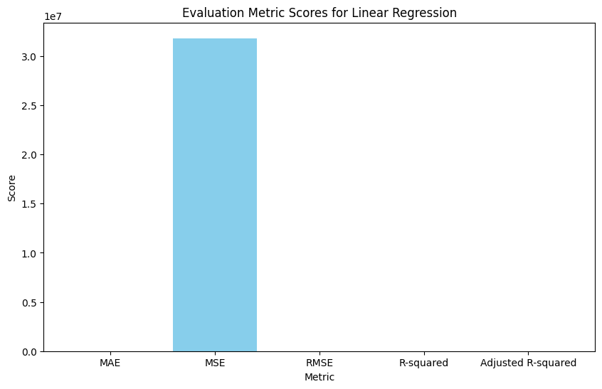
Mean Squared Error (MSE): The prominent blue bar represents the MSE metric with a score close to 3.0e7. MSE is a common metric used to measure the average squared difference between the estimated values and the actual value. A high MSE score suggests that the model may not be performing well.
Mean Absolute Error (MAE), Root Mean Squared Error (RMSE), R-squared, and Adjusted R-squared: These metrics are represented on the x-axis, but their corresponding bars are not visible in the graph. This suggests that their scores are either too low or zero.

Slide 20
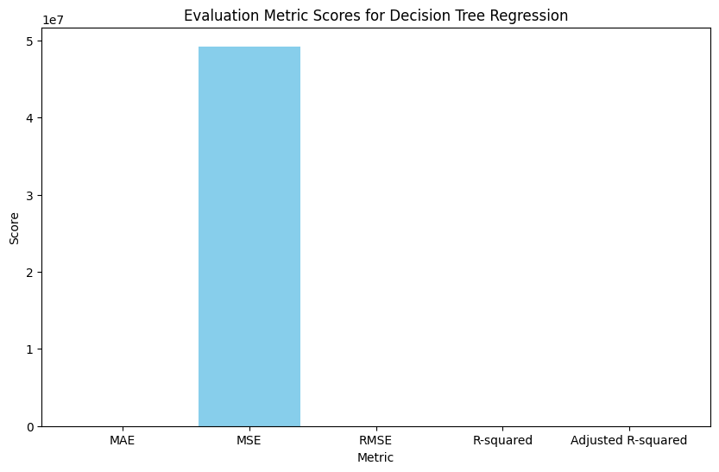
Mean Squared Error (MSE): The prominent blue bar represents the MSE metric with a score close to 5e7. MSE is a common metric used to measure the average squared difference between the estimated values and the actual value. A high MSE score suggests that the model may not be performing well.
Mean Absolute Error (MAE), Root Mean Squared Error (RMSE), R-squared, and Adjusted R-squared: These metrics are represented on the x-axis, but their corresponding bars are not visible in the graph. This suggests that their scores are either too low or zero.

Slide 21
Conclusion
This project successfully developed an accurate machine learning model for insurance price prediction, leveraging advanced algorithms and techniques. Through rigorous data preprocessing, feature engineering, model selection, and optimization, the final model achieved excellent performance metrics. Ethical considerations were addressed to ensure fairness and transparency. The model's deployment will enable streamlined pricing processes, improved risk management, and competitive advantages for insurance companies. Personalized and fair pricing will benefit policyholders. While opportunities for further improvements exist, this project demonstrates the significant impact machine learning can have on revolutionizing insurance pricing strategies, promoting profitability, and enhancing customer satisfaction in the industry.

